Slide 1
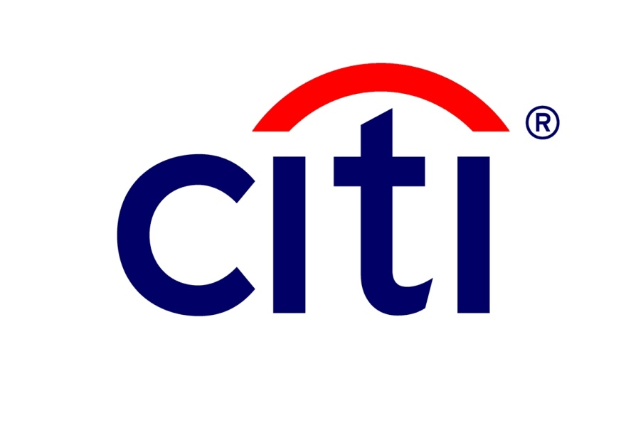
Code Management
Niall O’Hagan

Slide 2

Introduction & Background
Niall O’Hagan (Code Management)
Citi Belfast 2010 – Present, Applications Development Technical Specialist
Equities Middle Office Technology
12+ Years Software Development Experience

Slide 3
Code Management
Code Management = Version Control = Source Control = Revision Control
Managing change with multiple contributors for multiple purposes
Generally File/Directory based
Notes:
First Line = Analagous Terms
In our case, the structured management of code and code-related artifacts
Dependencies (or Dependency Links)
Source Code
But can really be used for anything that changes over time
Mutliple Contributors – Coordinating Overlapping Changes
Multiple Purpose – Releases being worked in parallel, etc.

Slide 4
Before Code Management
Shared Network Drives for group access
Co-ordinated access with “tokens” (a symbol of lock ownership)
Issues
Code clashes (simultaneous changes)
Complex, obscure “merges” (reconciling simultaneous changes)
“Dirty Writes” (lost updates due to simultaneous changes)
Suggesting a process, not mandating one
Notes:
Single Shared location, people generally used a virtual/physical “token” to say they have control – everyone else works around them
Common Issues
Code Clash – Parallel Conflicting Changes
When conflicts are detected, trying to resolve them
When conflicts aren’t detected – overwriting a change

Slide 5
The Lineage
Command Line / Local
1972 : SCCS – Source Code Control System
1982 : RCS – Revision Control System
Client - Server
1990 : CVS – Concurrent Versions System
1995 : Perforce
2000 : SVN – Subversion
Distributed
2005 : Git
Notes:
Distributed, every node (client) has a full copy, including history

Slide 6
The Basics
Repository (Remote) vs “Working Copy” (Local)
Authenticated & Authorised Access
Defined actions to
Synchronize (incoming vs outgoing)
Commit (to the Repository)
Update (from the Repository)
Resolve Conflicts
Notes:
Repository = Central Definitive Store (may be distributed)
Working Copy = Local Copy of Repository (or subset) with differences
Authenticated vs Authorised
Synchronize = List Incoming, Outgoing Changes & Conflicts
Commit = Apply outgoing changes to the Repository
Update = Apply incoming changes to Working Copy
Resolve = Flag that you have resolved conflicts and increment Version

Slide 7
Advanced
Binary vs Text
Merging/Conflict Resolution for Binary is manual
Atomicity
All changes committed as one
Versioning
Each commit is a new version of the file
Maintain the versions over time for recall/rollback
Conflict Resolution
Managed “merging” of parallel changes to a file
Branching & Tagging
Branch – parallel stream of development
Tag - checkpoint
Merges
Consolidating changes from multiple branches into 1
Notes:
Binary - (Library files, tools, etc) can be versioned, but merge is difficult
Text – can be compared for resolution
Atomicity – commit a number of change together, or none at all
Version – see history – when, who & why (including compare). Also allows you to go back to a version and compare the changes between version
Conflict Resolution – Line by Line compare, mark when resolved
Branching – creating parallel streams for development, unclear timelines, separate releases – maintains isolation from changes
Tagging – create a “checkpoint” in the code, a point to return to
Merge – re-integrate a branch
Version Recall – in extreme cases, revert all changes back to a certain version

Slide 8
Why?
“Golden” Repository
Integrated Development Environments (IDE) Support
Reduced Locking (use conflict resolution)
Issue Resolution
Code clashes still occur, but managed
Clarity on conflicts
Prevents version skipping
It’s not a substitue for communication, but it is an aid
Notes:
A Predictable, common process is easier to manage, and most importantly to fix when something does go wrong
A single repository gives a single Definitive Source
Locking is possible but generally unnecessary. Users commit as needed – if you detect a conflict its up to you to resolve it before committing.
Code clashes are readily detected
Conflict resolution gives a clear/simple process for resolving them
VC prevents you skipping a version (dirty write), you are forced to acknowledge and resovle the conflict

Slide 9

Commit-Update & Versions Example
User 1 Change
> User 1 Sync
> User 1 Commit
> User 2 Sync
> User 2 Update
User 2 Change
> User 2 Sync
> User 2 Commit
Repository
Change.java (1)
Change.java (2)
Working Copy
Working Copy
Change.java (1)
Change.java (1)
Change.java (2)
All user changes made in the “Working Copy”
Changes are shared via the “Repository”
Each committed change is a new version
Notes:
NOTE THAT THIS IS ANIMATED

Slide 10
Commit-Update & Versions – SVN/Eclipse Demo
Video
Notes:
“Sharing” a Project : 0:00
Adding a project to the repository for sharing
+ Commit initial code
+ View “History”
- Review Code : 0:00
- Actual Share : 2:10
- Commit & Verify : 3:00
- History : 4:15
- Checkout : 4:38
Checkout the shared project by another user
- Checkout 4:38
- Verify 5:33
- Making Changes : 5:50
Make changes to an already checked out project
- Making the Change : 5:50
- View & Synchronize : 6:51
- Commit Change : 7:28
- Sync & Update : 7:54
Receive changes to an already checked out project
- Synchronize : 7:54
- Update & Verify : 8:41

Slide 11
Managing Conflicts
Conflicts occur when users make parallel changes
On the same branch
When merging a branch
Locking
Pessimistic - Traditional “Exclusive” Lock
Optimistic – Check on Commit
Conflicts should be infrequent, it’s why most systems employ an Optimistic Locking Strategy
Notes:
Optimistic vs Pessimistic Examples & Explanation
Pessimistic =
- User acquires an exclusive lock on 1 or more files
- System prevents anyone else attempting changes until locks are released
- Forced client interaction
Optimistic =
- On commit include a condition that reflects the origin
- If that condition fails to match then subsequent changes have been made that need to be merged
e.g.
- On Get, version = 1146
- On commit, Commit change where version = 1146
- If no alternate changes, matches
- Version subsequently incremented on commit
- If alternate changes, match fails and nothing applied

Slide 12
Managing Conflict – SVN/Eclipse Demo
Video
Notes:
Normal Change : 0:00
Making a change by one user & committing to the repo
- Making Change : 0:00
- Commit : 0:35
- Conflict: 0:53
Making a change by another user that conflicts with the previous
+ Attempting to commit and detecting conflict
+ Resolving the conflict & Committing
- Conflicting Change 0:53
- Detection 1:25
- Resolving 1:50

Slide 13
Why Branch?
Branches
develop parallel “features”
manage independent timelines
Tags
Define checkpoints, i.e. save points
Return to checkpoints

Slide 14
Branch-Tag-Merge Example
Trunk
1
3
File A
Branch
2
4
T : 1
T : 1
B : 1, 2
T : 1,3
B : 1,2
T : 1,3
B : 1,2,4
T : 1,2,3,4
B : 1,2,4
Trunk is just a “special” branch – all things return here
On creation a branch is in sync with its origin
Changes applied to a branch are isolated from other branches
Merges – bring changes made on a branch back into another branch
Tag – read-only branch, used to mark/recall the state at a given time
Notes:
Branching Merging already touched on, but recap
Trunk = main line, all releases
Branch = single dev stream, generally a targetted release or large feature. Purpose is to isolate changes
Cover the incremental stages (dotted line), highlighting
What happened between the stages
The status of Branch/Trunk at each stage
Why separate :
Emergency Changes –Trunk and rebuild, ignoring future release
Deferred Releases

Slide 15
Branch-Tag-Merge – SVN/Eclipse Demo
Video
Notes:
- Branch : 0:00
Creating the parallel stream for development
+ Making branch changes
- Creating & Checkout 0:00
- Making Changes 1:25
- Commit 3:00
Compare Trunk : 3:30
Illustrate change made on the branch does not affect elsewhere (e.g. trunk)
- Sync & Check : 3:30
- Merge : 3:44
Blank workspace, checkout DESTINATION – NO CHANGES
+ Merge from Source - View Changes, Manage conflicts
+ Merge is only “local” still need to commit
- Checkout “Destination” 3:44
- Merge 4:39
- Changes & Conflicts 5:30
- Need Final commit 5:55

Slide 16
Best Practices
“Synchronize” regularily to minimize conflicts
Always “update” and re-compile before you “commit” code
Include a commit comment explaining the change
Make use of Atomic commits – either all changes are committed or none are
If in doubt check the history
“Branch” when the timeline for separate features is different or unclear
Binary files can be versioned, but co-ordinate changes
Delete unused artefacts (including code blocks)
Don’t Version Control “Generated” artefacts – build them
E.g. Files generated from an Interface definition
Notes:
Sync : Conflicts can be costly to resolve depdending on size, complexity & familiarity with the code.
Always Update : To Ensure that you changes are verified against the latest code. NEVER BREAK THE BUILD! Its costly to the team as a whole
Commit Comments are invaluable when resolving conflicts, they allow an understanding of why a change was made not just what changes. Also identifies a person to query
Atomic Commits : Commit all you changes for a “feature” together, all or nothing (as you will have dependencies within your code)
Branch : Allows you to defer affecting the mainline until you need the code in a release
Binary : No line-by-line compare, generally safer to communciate
Delete : You can always go back, its in the repo! Deleting allows to to clear out the irrelevant making the code clearer.
Generated : Especially “class” files. These can always be retreived by re-generating, make sure to version control the process to generate & the generation “source” though

Slide 17
Questions?

